Slide 1
Azure OpenAI Cases

Slide 2
A copilot for every Microsoft Cloud experience
Microsoft 365 Copilot
Dynamics 365 Copilot
Copilot in Power Platform
Microsoft Security Copilot
GitHub Copilot
Works alongside you in the apps you use every day
Turbocharge your workforce with a copilot for every job role
Imagine it, describe it, and Power Platform builds it
Defend at machine speed with Microsoft Security Copilot
Increase developer productivity to accelerate innovation
Learn more
Learn more
Learn more
Learn more
Learn more
Resources
Notes:
MS Partner Lead the Era of AI Transform page

Slide 3
Unlock new use cases
Top Use Cases
Writing assistance | Government agency using Azure OpenAI Service to extract and summarize key information from their extensive library of rural development reports Financial services using Azure OpenAI Service to summarize financial reporting for peer risk analysis and customer conversation summarization
Code generation | Aircraft company using to convert natural language to SQL for aircraft telemetry data Consulting service using Azure OpenAI Service to convert natural language to query propriety data models
Reasoning over data | Financial services firm using Azure OpenAI Service to improve search capabilities and the conversational quality of a customer’s Bot experience. Insurance companies extract information from volumes of unstructured data to automate claim handling processes
Summarization | International insurance company using Azure OpenAI Service to provide summaries of call center customer support conversation logs Global bank using Azure OpenAI Service to summarize financial reporting and analyst articles

Slide 4

Azure OpenAI Service Use Cases
Language
Reason over structured and unstructured data: Classification, Sentiment, Entity Extraction, Search
Refined text-based search with embeddings
Product feedback sentiment
Customer and employee feedback classification
Claims and risk analyses
Support emails and call transcripts
Social media trends
Writing Assistance
Marketing copy / email taglines
Long format text
Paragraphs from bullets
Summarization
Call center call transcripts
Subject Matter Expert Documents
Competitive analysis
Peer Analysis
Technical reports
Product and service feedback
Social media trends
Conversational AI
Smart assists for call centers
Tech support chat bots
Virtual assistants
Artificial humans
Codex
Natural Language to Code
Natural Language to SQL
Code to Natural Language
Code documentation
Refactoring
Use Cases that use multiple model capabilities
Contact Centers
Classification – route mails to appropriate team
Sentiment – prioritize angry customers
Entity extraction and search – analyze liability and risk
Mail and call transcript summarization
Customer response email generation
Rapid response marketing campaigns: classification, sentiment, summarization, content generation, image generation
DALL·E 2
Creative ideation
Podcast and music playlist images
Content syndication
Marketing campaign personalization
Hyper-personalization

Slide 5



Nationale Nederlanden case study
"Nationale-Nederlanden part of NN Group, the largest player in the Dutch insurance market is using the Azure OpenAI services to extract information from large volumes of unstructured data to automate their claim handling processes. The Azure OpenAI services provide the building blocks to quickly develop AI solutions that understand Dutch text. This opens the door to many other user cases.“
Tjerrie Smit
Head of Data & AI

Slide 6



HSBC case study
“HSBC Bank is one of the largest banking and financial services institutions in the world, serving millions of customers globally. Microsoft’s Azure OpenAI have been a key strategic partner to help us adopt and operationalize novel methods in the Natural Language space. As an organization we see huge potential in Large Models for summarization and classification of financial information; and also programming applications for our community of citizen scientist. Pro tem we continue to seek for opportunities to bring such benefits to 120K support function colleagues worldwide.”
Dan Dixon
Head of Data & AI

Slide 7
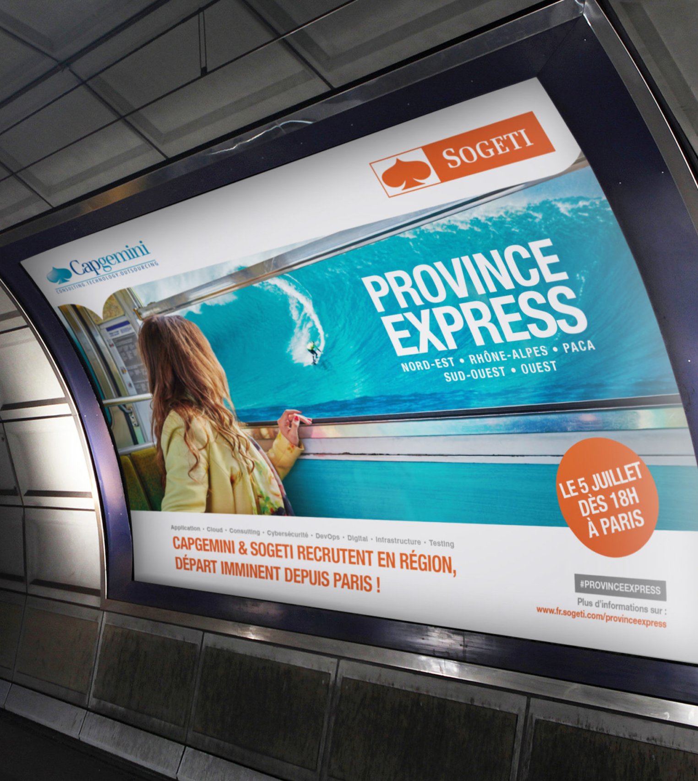
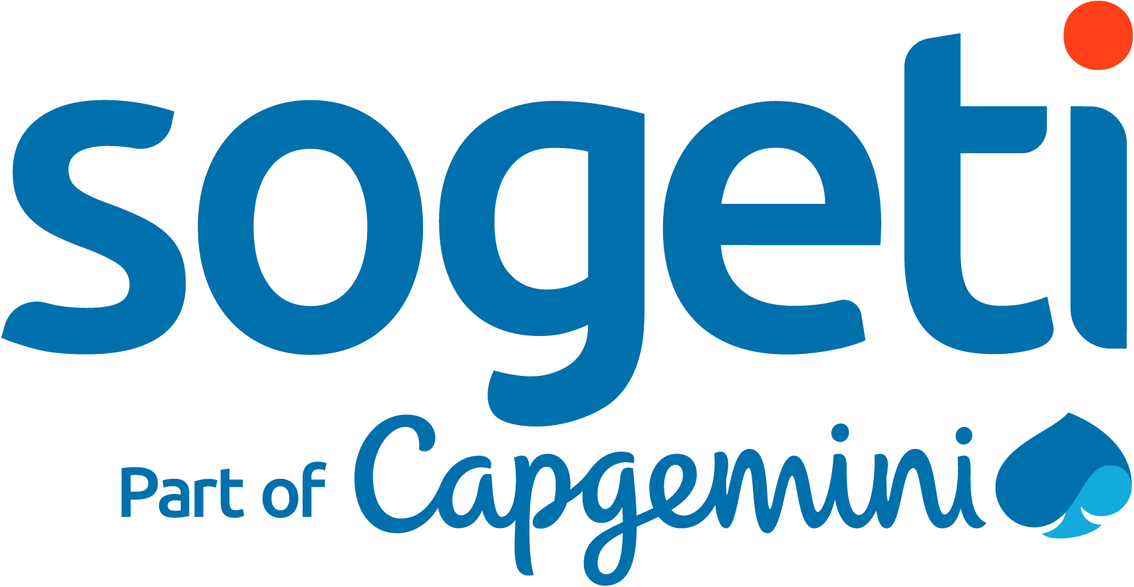
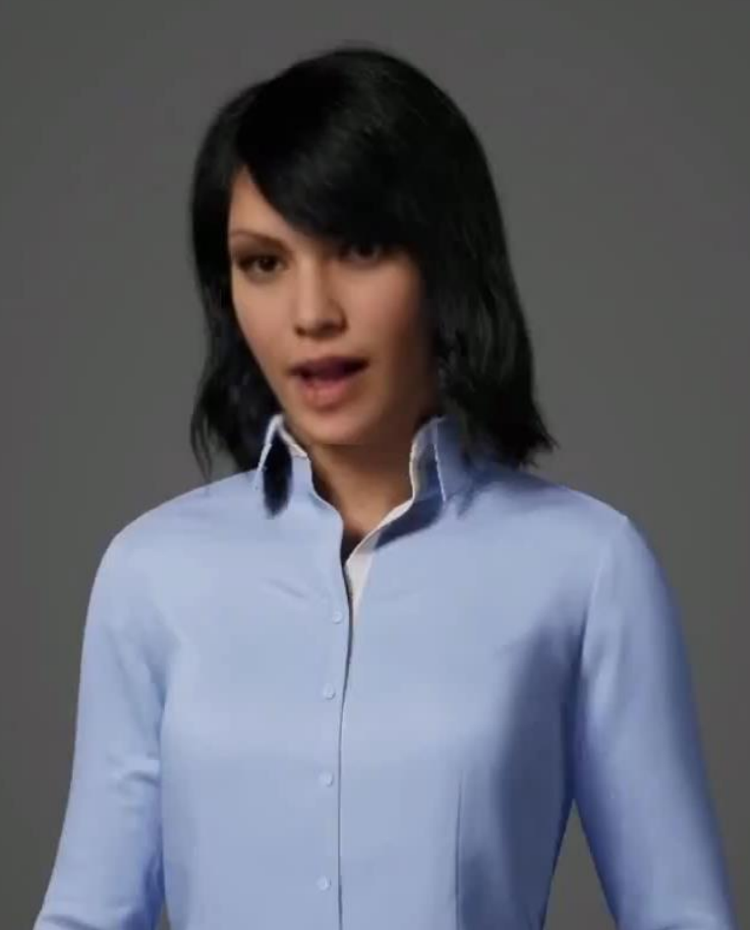
Sogeti case study
“Sogeti constantly looks for new ways to enable clients in their digital transformation journey by providing cutting-edge solutions in AI and ML. Sogeti uses Azure OpenAI service for its digital human (Daisy) offering that enables end users to have a human like conversation. Azure OpenAI service backed up by a strong language model, has helped Daisy to learn custom data specific to a domain or client, accelerated response times, gained knowledge from the internet and much more. Azure OpenAI service has helped Sogeti to take its digital human offering to various Azure enabled clients easily and helped reduced implementation time. “
—Mark Oost - Sogeti Chief Technology Officer, Artificial Intelligence and Machine Learning

Slide 8
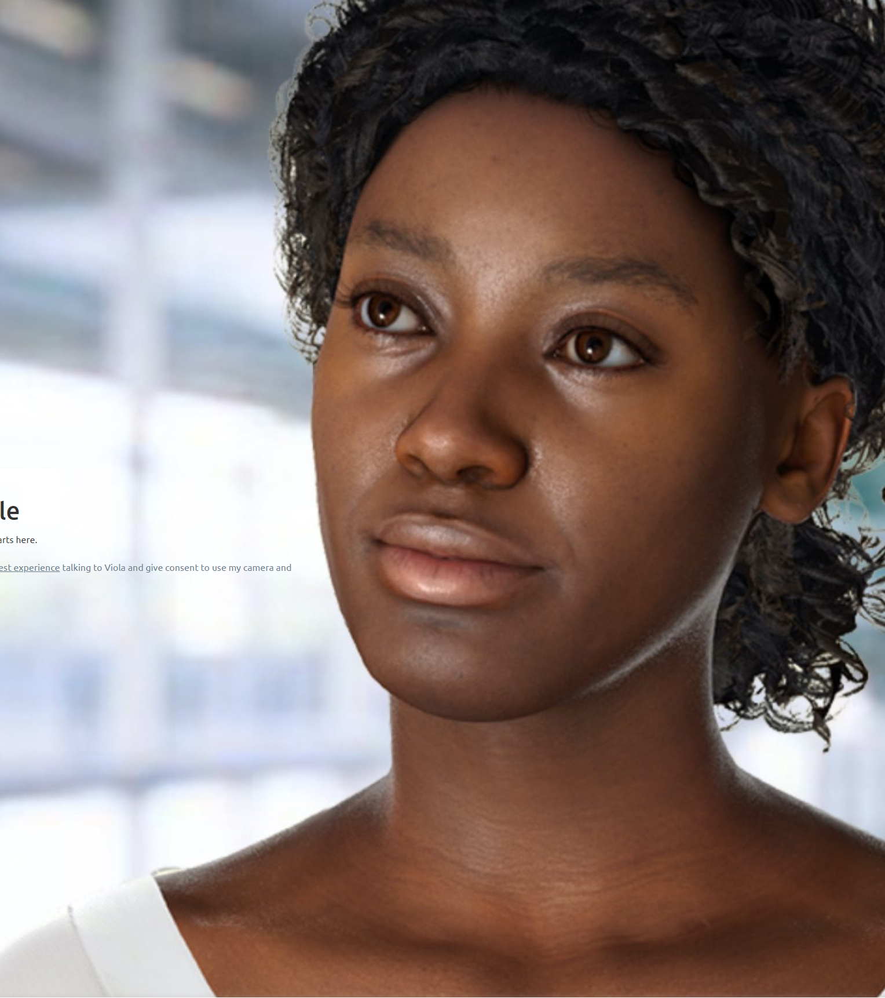

Soul machines case study
Soul Machines creates digital people that transform brand experience by creating engaging and emotional connections with customers.
Soul Machines is using OpenAI for sentiment to increase the empathy of their Digital People so that conversations with users are deeper and more meaningful.
“Soul Machines is using Azure OpenAI Service for autonomous content generation for their media and entertainment products. For example, the content generation enables them to produce copy for conversations with their digital avatars and celebrities.”

Slide 9
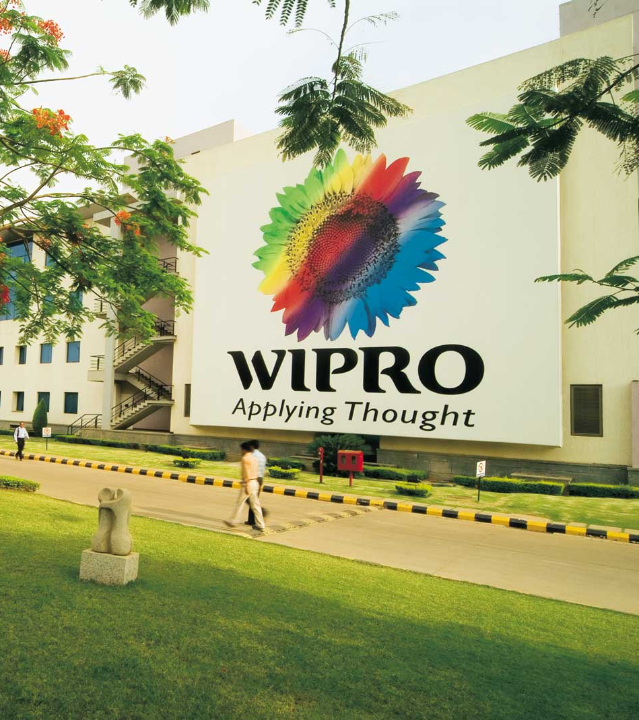

Wipro case study
"Wipro Ltd, a leading global information technology company is using Azure Cognitive Services to build Conversational AI solutions.
The solution, offers personalized IT support and enhanced employee engagement initiatives and is being used by 65,000 Wipro employees globally. The platform uses a combination of Azure natural language-understanding APIs along with customized Machine Language models.
These are powered by Azure Machine Learning Studio and Azure Open AI to foster personalized employee-experience within the organization.”
– Anup Purohit, Global CIO, Wipro Ltd.

Slide 10
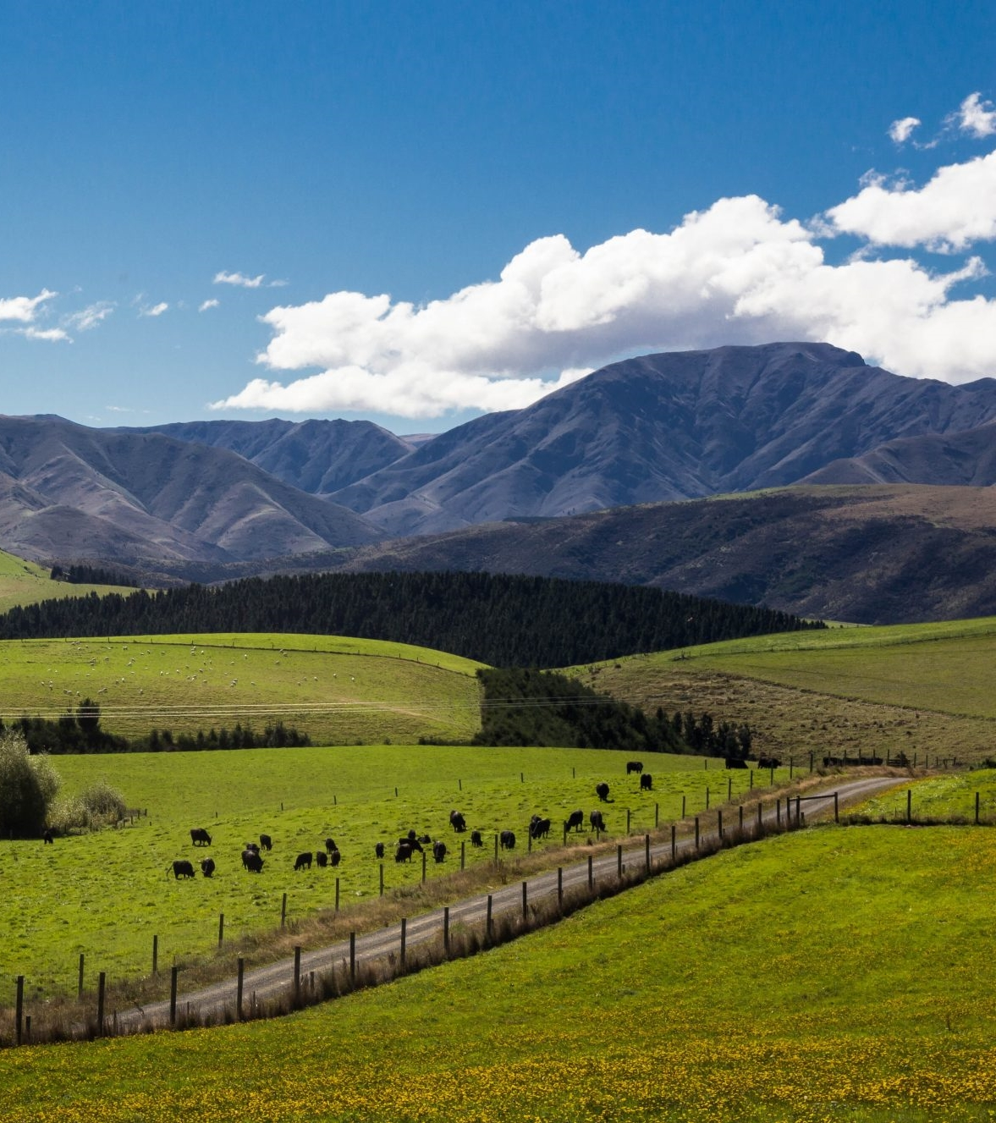

Farmlands Co-op case study
Farmlands is the largest agriculture products buying group in New Zealand. They have 450,000+ interactions with customers every year, documented in Dynamics 365.
They are using Azure OpenAI Service to gain an understanding of sentiment around key words or phrases that emerge in cases logged in Dynamics.
They are using Davinci and Curie to highlight currently trending key phrases; prepare summaries and enable users to drill down and look at case or interaction summaries.
“It saves our call center staff time and improves our customers’ experience”
– Gareth Pullar, insights and analytics manager at Farmlands.
“In terms of generating content, it’s a game-changer. “It’s just really exciting technology.”
– Jean van Schalkwyk, Business Intelligence Lead

Slide 11

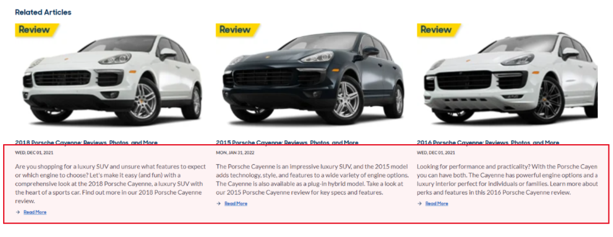

Carmax case study (alt.)
CarMax is using Azure OpenAI Service for vehicle and store review summarization, creating marketing content, and preparing vehicle trim comparisons. Using OpenAI reduces their marketing freelancer spend and enables them to provide new information to their customers faster than their competitors
“With Azure OpenAI Service, we are able to create content that empowers our customers so they can be informed before they make a decision,”
Shamim Mohammad, CarMax executive vice president and chief information and technology officer. “
“OpenAI Service is definitely playing a big part in our SEO improvement.”
Sean Goetz, Director, Application Systems

Slide 12

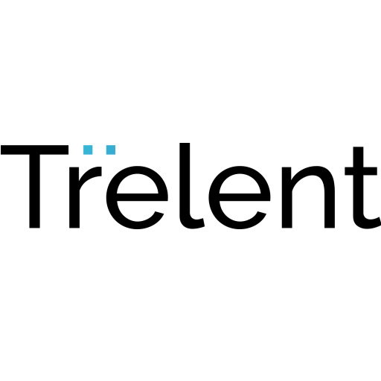
Trelent case study
Customer: Trelent
Industry: Professional Services
Size: 1-49 employees
Country: Canada Products and services: Azure OpenAI Service
Read full story here
“With a product like OpenAI Service behind you, you can focus a lot more on what really matters, which is delivering a great experience, a great product, and a lot of value to your customers.”
—Calum Bird, CEO, Trelent
Trelent, a pre-seed code documentation startup that uses the OpenAI Codex algorithm, found its audience in high-growth tech companies with large or distributed engineering teams. The problem: How does a two-person team provide enterprise-ready service?
A Microsoft for Startups webinar provided the answer: Microsoft Azure OpenAI Service paired the powerful OpenAI algorithms Trelent was already using with Azure security, safety controls, and global availability—and worked with the startup’s existing solution.
With Azure OpenAI Service, Trelent benefits from content filtering, increased security, and faster response times (from 1-3s down to an average of 750ms). Those enterprise-ready features free Trelent engineers up to focus on their core innovation.

